Slide 1
UPPER SIXTH ARTS
GEOGRAPHY
Lesson 5
Global Warming
Notes:
Good morning, class, and welcome to our geography lesson. I am your geography teacher, Mr Kamdem. Today we are starting Lesson 5: Global Warming.

Slide 2
CLASS INFO
Class, Chapter and Duration
Class | Upper Sixth Arts
Chapter | Module 7: Understanding and managing contemporary environmental and development issues
Duration | 2 periods (2 × 50 minutes)
Notes:
This lesson is for Upper Sixth Arts. It belongs to Module 7: Understanding and managing contemporary environmental and development issues. We shall need 2 periods to cover it.

Slide 3
IDENTIFICATION
Lesson Identification
Topic | Contemporary Environmental Issues
Sub-topic | Climate Change
Lesson | Lesson 5: Global Warming
Notions / Concepts | Global warming, greenhouse effect, mitigation, adaptation, Paris Agreement.
Syllabus focus | Meaning and trends; causes and consequences; adaptation and mitigation measures.
Competence | Learners are able to explain global warming and propose adaptation and mitigation measures.
Notes:
Our topic is Contemporary Environmental Issues, and the sub-topic is Climate Change. The key notions we shall use today are: global warming, greenhouse effect, mitigation, adaptation, Paris Agreement. At the end, you should be able to do this: learners are able to explain global warming and propose adaptation and mitigation measures.

Slide 4

HOMEWORK CORRECTION
Correction of the Homework
Question (Lesson 4: Climatic Change):
Ask two elders how the seasons have changed and write their answers.
Notes:
Before we start the new lesson, let us correct the homework I gave you at the end of Lesson 4: Climatic Change. The question was: Ask two elders how the seasons have changed and write their answers. Take out your exercise books.

Slide 5
HOMEWORK CORRECTION
Correction: Possible Answer
Answers vary. Typical reply: the rains start later and stop earlier, dry spells in the rainy season are longer, heat is stronger, and floods have become more frequent.
Notes:
Here is a good answer. Answers vary. Typical reply: the rains start later and stop earlier, dry spells in the rainy season are longer, heat is stronger, and floods have become more frequent. Compare it with your own answer and correct your work in red.

Slide 6
LESSON PLAN
Lesson Plan
Correction of the homework
Objectives and recall
Real-life situation and action to take
Learning activities
Board summary
Evaluation, remediation and homework
Notes:
Here is the plan of our lesson today. First, we shall correct the homework. Then we shall look at the objectives and recall what you already know. After that, we shall study a situation from real life and the action to take, and do the learning activities. Finally, we shall copy the board summary, do the evaluation and the remediation, and I will give you the homework.

Slide 7
OBJECTIVES
Objectives
By the end of this lesson, you should be able to:
Define global warming and describe its trend.
Explain its causes and consequences.
Notes:
Take your time to copy this part; we will continue together.

Slide 8
OBJECTIVES
Objectives (continued)
Distinguish and propose mitigation and adaptation measures.
Notes:
By the end of this lesson, you should be able to do three things. Number 1: define global warming and describe its trend. Number 2: explain its causes and consequences. Number 3: distinguish and propose mitigation and adaptation measures.

Slide 9
PREVIOUS KNOWLEDGE
Previous Knowledge
Greenhouse gases trap heat.
The world is getting warmer.
Notes:
Let us first remember what you already know. Greenhouse gases trap heat. The world is getting warmer. Keep this in mind, because we shall build on it today.

Slide 10
REAL-LIFE SITUATION
Situation in Real Life
In the Sahel, droughts are more frequent; on the coast, the sea eats into the beaches of Limbe and Kribi. The government of Cameroon has signed the Paris Agreement to reduce emissions.
Notes:
Listen carefully to this situation from real life. In the Sahel, droughts are more frequent; on the coast, the sea eats into the beaches of Limbe and Kribi. The government of Cameroon has signed the Paris Agreement to reduce emissions. Think about it, because I am going to ask you some questions.

Slide 11
REAL-LIFE SITUATION
Situation: Question 1
What is the problem in the situation?
Notes:
Question 1: What is the problem in the situation? Think for a moment, then raise your hand to answer.

Slide 12
REAL-LIFE SITUATION
Answer
Global warming affects Cameroon.
Notes:
Good. Global warming affects Cameroon.

Slide 13
REAL-LIFE SITUATION
Situation: Question 2
Give two effects in the situation.
Notes:
Question 2: Give two effects in the situation. Think for a moment, then raise your hand to answer.

Slide 14
REAL-LIFE SITUATION
Answer
Droughts and coastal erosion.
Notes:
Good. Droughts and coastal erosion.

Slide 15
REAL-LIFE SITUATION
Situation: Question 3
What did the government sign?
Notes:
Question 3: What did the government sign? Think for a moment, then raise your hand to answer.

Slide 16
REAL-LIFE SITUATION
Possible Answer
The Paris Agreement.
Notes:
Good. The Paris Agreement.

Slide 17
ACTION TO TAKE
Action to Take
Save energy and plant trees to limit global warming.
Notes:
From this situation, the action we are working towards in this lesson is the following: save energy and plant trees to limit global warming.

Slide 18
JUSTIFICATION
Justification of the Lesson
This lesson helps us to understand global warming and how to respond to it.
Notes:
Why is this lesson important for you? This lesson helps us to understand global warming and how to respond to it.

Slide 19

1. MEANING OF GLOBAL WARMING
Activity 1
The greenhouse effect.
Notes:
Activity 1. Look carefully at this diagram: the greenhouse effect. Observe every detail before I ask the question.

Slide 20
1. MEANING OF GLOBAL WARMING
Activity 1: Question
Explain the greenhouse effect.
Notes:
Here is the question for Activity 1: Explain the greenhouse effect. Take one minute to think and write your answer in your rough notebook.

Slide 21
1. MEANING OF GLOBAL WARMING
Activity 1: Answer
Sunlight warms the Earth and greenhouse gases trap part of the heat.
Notes:
Let us check the answer together. Sunlight warms the Earth and greenhouse gases trap part of the heat.

Slide 22
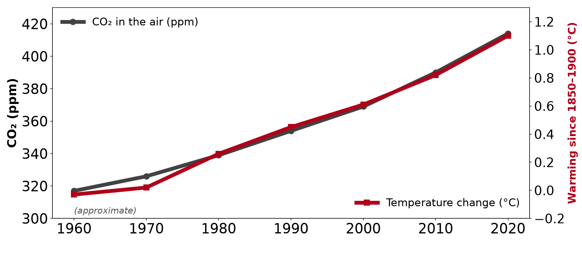
1. TRENDS
Activity 2
CO₂ and temperature (approximate).
Notes:
Activity 2. Look carefully at this diagram: cO₂ and temperature (approximate). Observe every detail before I ask the question.

Slide 23
1. TRENDS
Activity 2: Question
Why is warming called "enhanced" today?
Notes:
Here is the question for Activity 2: Why is warming called "enhanced" today? Take one minute to think and write your answer in your rough notebook.

Slide 24
1. TRENDS
Activity 2: Answer
People add extra greenhouse gases, so more heat is trapped.
Notes:
Let us check the answer together. People add extra greenhouse gases, so more heat is trapped.

Slide 25
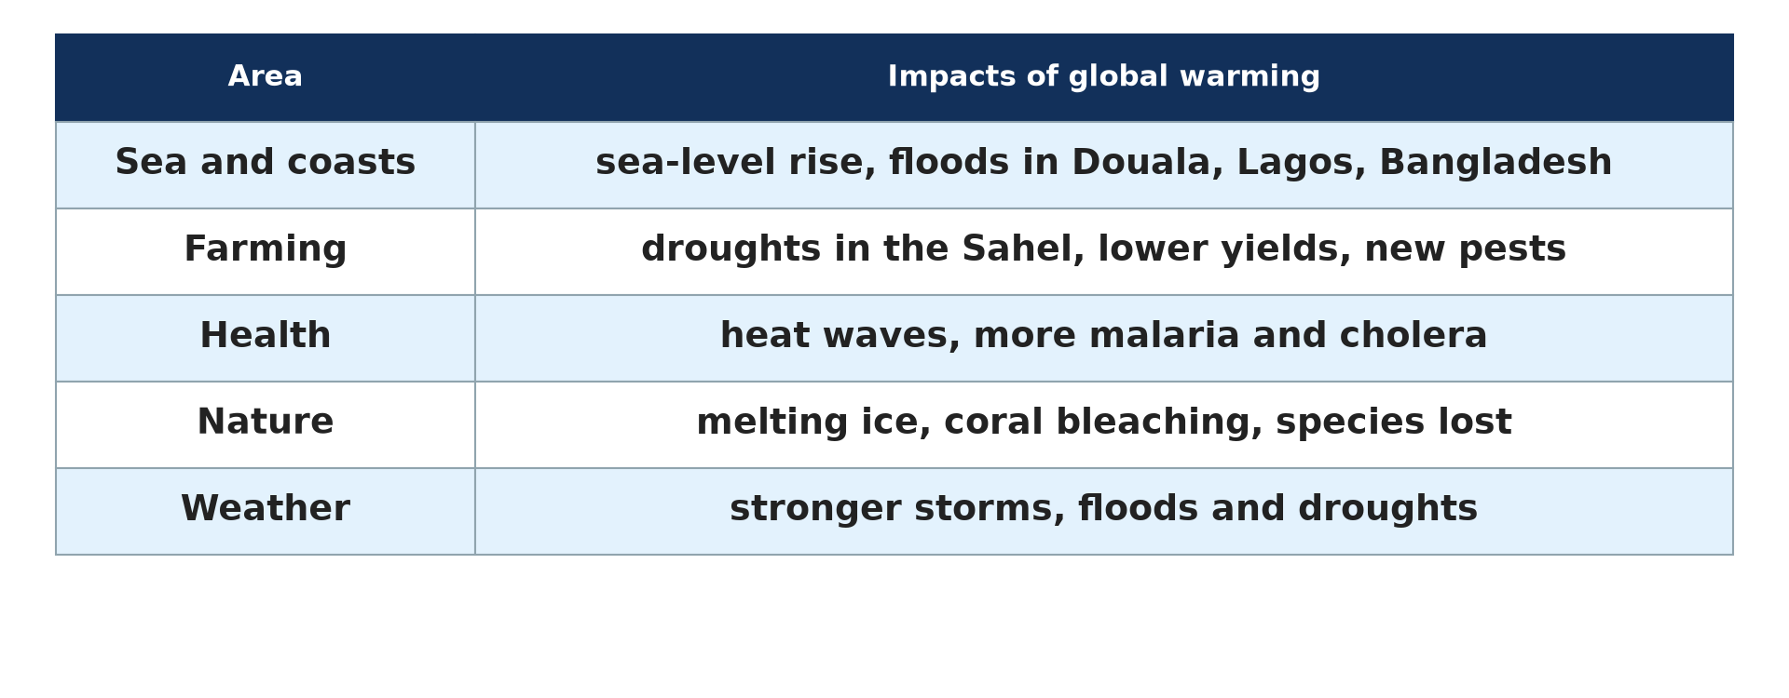
2. CONSEQUENCES
Activity 3
Impacts of global warming.
Notes:
Activity 3. Look carefully at this diagram: impacts of global warming. Observe every detail before I ask the question.

Slide 26
2. CONSEQUENCES
Activity 3: Question
Give three consequences of global warming.
Notes:
Here is the question for Activity 3: Give three consequences of global warming. Take one minute to think and write your answer in your rough notebook.

Slide 27
2. CONSEQUENCES
Activity 3: Answer
Sea-level rise, droughts and more malaria.
Notes:
Let us check the answer together. Sea-level rise, droughts and more malaria.

Slide 28

3. MITIGATION
Activity 4
Solar panels.
Notes:
Activity 4. Look carefully at this picture: solar panels. Observe every detail before I ask the question.

Slide 29
3. MITIGATION
Activity 4: Question
How does solar energy mitigate global warming?
Notes:
Here is the question for Activity 4: How does solar energy mitigate global warming? Take one minute to think and write your answer in your rough notebook.

Slide 30
3. MITIGATION
Activity 4: Answer
It produces electricity without greenhouse gases.
Notes:
Let us check the answer together. It produces electricity without greenhouse gases.

Slide 31
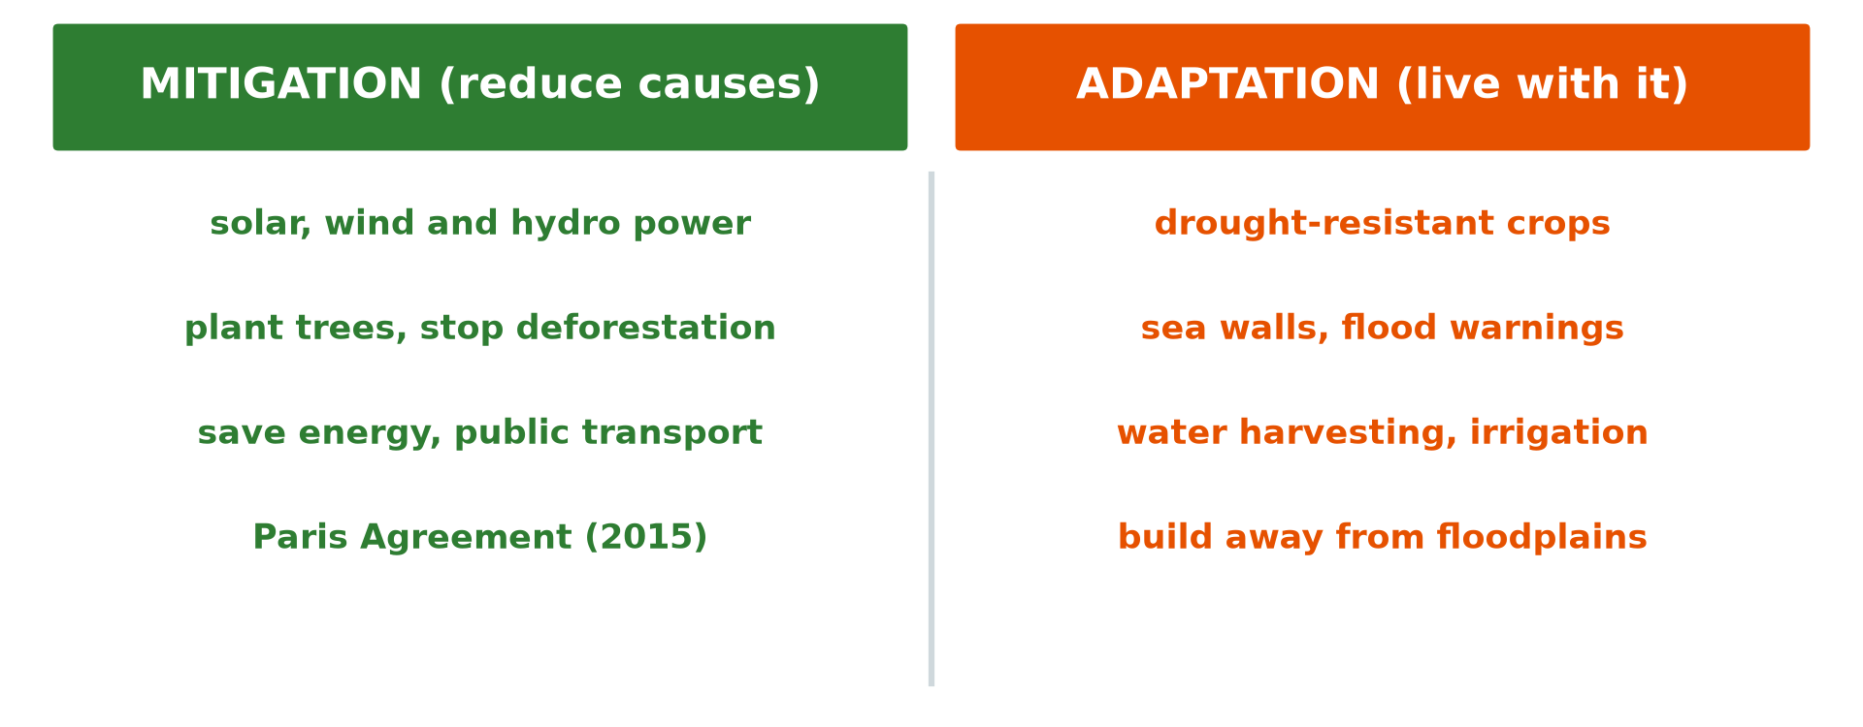
3. ADAPTATION
Activity 5
Mitigation and adaptation.
Notes:
Activity 5. Look carefully at this diagram: mitigation and adaptation. Observe every detail before I ask the question.

Slide 32
3. ADAPTATION
Activity 5: Question
Distinguish mitigation and adaptation.
Notes:
Here is the question for Activity 5: Distinguish mitigation and adaptation. Take one minute to think and write your answer in your rough notebook.

Slide 33
3. ADAPTATION
Activity 5: Answer
Mitigation reduces the causes; adaptation helps people live with the effects.
Notes:
Let us check the answer together. Mitigation reduces the causes; adaptation helps people live with the effects.

Slide 34
BOARD SUMMARY
Board Summary
Topic: Contemporary Environmental Issues
Sub-topic: Climate Change
Lesson 5: Global Warming
Notes:
Now we are going to copy the board summary. Write the title and the headings neatly in your notebooks. I will give you enough time for each slide, so do not rush.

Slide 35
BOARD SUMMARY
1. Meaning and Trends of Global Warming
Global warming can be explained as follows:
Global warming: It is the rise in the average temperature of the Earth. It is caused by the enhanced greenhouse effect.
Notes:
Let us copy Meaning and Trends of Global Warming. Global warming can be explained as follows. On this slide we have Global warming. Write each point on a new line, with the key term first, and explain it in your own words when we revise. When you finish, we go to the next slide.

Slide 36
BOARD SUMMARY
1. Meaning and Trends of Global Warming (continued)
Greenhouse effect: Greenhouse gases let sunlight in but trap part of the heat given off by the Earth. More gases trap more heat, which enhances the natural effect.
Trends: The world has warmed by about 1.1 °C since 1850, and most of it since 1970. The warmest years on record are all recent.
Notes:
We continue with Meaning and Trends of Global Warming. On this slide we have Greenhouse effect and Trends. Write each point on a new line, with the key term first, and explain it in your own words when we revise.

Slide 37
BOARD SUMMARY
1. Meaning and Trends of Global Warming
Illustration: the greenhouse effect
Notes:
Now draw this illustration in your notebook: the greenhouse effect. Give it a title and label it clearly.

Slide 38
BOARD SUMMARY
2. Causes and Consequences
Global warming has the following causes and consequences:
Causes: Extra greenhouse gases come from burning fossil fuels, deforestation and farming. Industrial countries and China emit the most.
Notes:
Let us copy Causes and Consequences. Global warming has the following causes and consequences. On this slide we have Causes. Write each point on a new line, with the key term first, and explain it in your own words when we revise. When you finish, we go to the next slide.

Slide 39
BOARD SUMMARY
2. Causes and Consequences (continued)
Consequences: Ice melts, the sea level rises and droughts, floods and storms become more frequent. Crops, water supply and health suffer, especially in poor countries.
Notes:
We continue with Causes and Consequences. On this slide we have Consequences. Write each point on a new line, with the key term first, and explain it in your own words when we revise.

Slide 40
BOARD SUMMARY
2. Causes and Consequences
Illustration: impacts of global warming
Notes:
Now draw this illustration in your notebook: impacts of global warming. Give it a title and label it clearly.

Slide 41
BOARD SUMMARY
3. Mitigation and Adaptation Measures
Two kinds of measures respond to global warming:
Mitigation: It is reducing the causes of warming by cutting emissions. Renewable energy, energy saving and tree planting reduce emissions, and the Paris Agreement (2015) aims to limit warming to 1.5–2 °C.
Notes:
Let us copy Mitigation and Adaptation Measures. Two kinds of measures respond to global warming. On this slide we have Mitigation. Write each point on a new line, with the key term first, and explain it in your own words when we revise. When you finish, we go to the next slide.

Slide 42
BOARD SUMMARY
3. Mitigation and Adaptation Measures (continued)
Adaptation: It is adjusting to the effects of warming. Drought-resistant crops, dykes, early warning systems and water storage are examples.
Notes:
We continue with Mitigation and Adaptation Measures. On this slide we have Adaptation. Write each point on a new line, with the key term first, and explain it in your own words when we revise.

Slide 43
BOARD SUMMARY
3. Mitigation and Adaptation Measures
Illustration: mitigation and adaptation
Notes:
Now draw this illustration in your notebook: mitigation and adaptation. Give it a title and label it clearly.

Slide 44
FORMATIVE EVALUATION
Evaluation 1
Give two causes and two consequences of global warming.
Notes:
Now let us check what you have understood. Question 1: Give two causes and two consequences of global warming. Answer in your exercise book.

Slide 45
FORMATIVE EVALUATION
Expected Answer
Causes: burning fuels, deforestation. Consequences: sea-level rise, droughts.
Notes:
The expected answer is: causes: burning fuels, deforestation. Consequences: sea-level rise, droughts. If you got it right, well done.

Slide 46
FORMATIVE EVALUATION
Evaluation 2
Give one mitigation and one adaptation measure.
Notes:
Now let us check what you have understood. Question 2: Give one mitigation and one adaptation measure. Answer in your exercise book.

Slide 47
FORMATIVE EVALUATION
Expected Answer
Mitigation: solar power. Adaptation: drought-resistant crops.
Notes:
The expected answer is: mitigation: solar power. Adaptation: drought-resistant crops. If you got it right, well done.

Slide 48
REMEDIATION
Remediation
Fill in the blanks:
Reducing the causes is ______.
Living with the effects is ______.
The 2015 climate treaty is the ______ Agreement.
Notes:
For those who need more practice, fill in the blanks in your exercise book. The answers are: number 1, mitigation; number 2, adaptation; number 3, Paris.

Slide 49
HOMEWORK
Homework
Propose three actions your school can take to reduce greenhouse gases.
Notes:
For your homework: Propose three actions your school can take to reduce greenhouse gases. We shall correct it at the beginning of our next lesson.

Slide 50
NEXT LESSON
Next Lesson
Our next lesson will be on:
Lesson 6: Flooding
Notes:
Our next lesson will be on Lesson 6: Flooding. Thank you for your attention, and see you next time.

Slide 51
BILINGUAL GAME
Bilingual Game (Jeu Bilingue)
English | Français
Global warming | Le réchauffement climatique
Heat | La chaleur
Mitigation | L'atténuation
Adaptation | L'adaptation
Renewable energy | L'énergie renouvelable
Emissions | Les émissions
Notes:
Let us play the bilingual game. I say a word in English, and you give me the French word. Then we do the reverse.

Slide 52
LOGBOOK
Official Logbook (1/2)
Module / Topic | Contemporary Environmental Issues
Lesson Title | Lesson 5: Global Warming
Expected Learning Outcomes | Define global warming and describe its trend. Explain its causes and consequences. Distinguish and propose mitigation and adaptation measures.
Competence | Learners are able to explain global warming and propose adaptation and mitigation measures.
Notes:
I record this information in the official logbook of the class after the lesson.

Slide 53
LOGBOOK
Official Logbook (2/2)
Matter Taught | Meaning and Trends of Global Warming; Causes and Consequences; Mitigation and Adaptation Measures.
Evaluation | Formative evaluation and remediation exercise.
Homework | Propose three actions your school can take to reduce greenhouse gases.
Enrolment / Present / Absent | ____ / ____ / ____
Achievement | To be completed after the lesson.
Notes:
I complete the second page of the logbook: the matter taught, the evaluation, the homework and the attendance.

Slide 54
TEACHER'S NOTE
Teacher's Note
Timing: Homework correction, plan, objectives 8 min | Recall, situation, action 10 min | 5 activities 30 min | Board summary (copying) 30 min | Evaluation, remediation 10 min | Homework, next lesson 5 min | Logbook 7 min
Without the projector (Activity 1): describe the steps.
Without the projector (Activity 2): read the graph.
Without the projector (Activity 3): list local effects.
Without the projector (Activity 4): discuss clean energy.
Without the projector (Activity 5): sort the measures.
Notes:
This slide is for me, the teacher: it gives the timing of the lesson and what to do if the projector is not available.

Slide 55
REFERENCES
References
National Geography Syllabus, MINESEC/IGE/IP-SS, 2019 — Module 7 (Environment and Development).
Photo, Activity 4: “Noor Ouarzazate III Solar Plant” by Richard Allaway, CC BY 2.0, via Flickr (https://www.flickr.com/photos/16287002@N00/52769922684)
Diagrams and animations: drawn for this lesson (Geography Department).
Notes:
These are the references and picture credits used to prepare this lesson.

